Slide 1
Appendix G – Elevator Events and Listener Interfaces
Outline
G.1 Introduction
G.2 Events
G.3 Listeners
G.4 Component Diagrams Revisited

Slide 2
G.1 Introduction
Event handling
  Object register as “listeners” for events
    The class of that object must implement a “listener” interface

Slide 3
G.2 Events
Figures G.1-G.7 contain system events
  Each event inherits from class ElevatorModelEvent

Slide 4
Fig. G.1 ElevatorModel-Event superclass for events in the elevator simulation model.
Line 8
Line 11
Line 14
1 // ElevatorModelEvent.java
2 // Basic event packet in Elevator simulation
3 package com.deitel.jhtp4.elevator.event;
4
5 // Deitel packages
6 import com.deitel.jhtp4.elevator.model.*;
7
8 public class ElevatorModelEvent {
9
10 // Location where ElevatorModelEvent was generated
11 private Location location;
12
13 // source Object that generated ElevatorModelEvent
14 private Object source;
15
16 // ElevatorModelEvent constructor sets Location
17 public ElevatorModelEvent( Object source, Location location )
18 {
19 setSource( source );
20 setLocation( location );
21 }
22
23 // set ElevatorModelEvent Location
24 public void setLocation( Location eventLocation )
25 {
26 location = eventLocation;
27 }
28
29 // get ElevatorModelEvent Location
30 public Location getLocation()
31 {
32 return location;
33 }
Class ElevatorModelEvent is the superclass for all events in elevator simulation case study
Location object represents where the event was generated (i.e., Floor or Elevator)
Object object represents the actual Object that generated the event

Slide 5
Fig. G.1 ElevatorModel-Event superclass for events in the elevator simulation model (Part 2).
34
35 // set ElevatorModelEvent source
36 private void setSource( Object eventSource )
37 {
38 source = eventSource;
39 }
40
41 // get ElevatorModelEvent source
42 public Object getSource()
43 {
44 return source;
45 }
46 }

Slide 6
Fig. G.2 BellEvent ElevatorModel-Event subclass indicating that the Bell has rung.
Lines 8-15
1 // BellEvent.java
2 // Indicates that Bell has rung
3 package com.deitel.jhtp4.elevator.event;
4
5 // Deitel packages
6 import com.deitel.jhtp4.elevator.model*;
7
8 public class BellEvent extends ElevatorModelEvent {
9
10 // BellEvent constructor
11 public BellEvent( Object source, Location location )
12 {
13 super( source, location );
14 }
15 }
BellEvent sent when Bell has rung

Slide 7
Fig. G.3 ButtonEvent ElevatorModel-Event subclass indicating that a Button has changed state.
Lines 8-15
1 // ButtonEvent.java
2 // Indicates that a Button has changed state
3 package com.deitel.jhtp4.elevator.event;
4
5 // Deitel packages
6 import com.deitel.jhtp4.elevator.model.*;
7
8 public class ButtonEvent extends ElevatorModelEvent {
9
10 // ButtonEvent constructor
11 public ButtonEvent( Object source, Location location )
12 {
13 super( source, location );
14 }
15 }
ButtonEvent sent when Button as been pressed or reset

Slide 8
Fig. G.4 DoorEvent ElevatorModel-Event subclass indicating that a Door has changed state.
Lines 8-15
1 // DoorEvent.java
2 // Indicates that a Door has changed state
3 package com.deitel.jhtp4.elevator.event;
4
5 // Deitel packages
6 import com.deitel.jhtp4.elevator.model.*;
7
8 public class DoorEvent extends ElevatorModelEvent {
9
10 // DoorEvent constructor
11 public DoorEvent( Object source, Location location )
12 {
13 super( source, location );
14 }
15 }
DoorEvent sent when Door has opened or closed

Slide 9
Fig. G.5 ElevatorMove-Event Elevator-ModelEvent subclass indicating on which Floor the Elevator has either arrived or departed.
Lines 8-15
1 // ElevatorMoveEvent.java
2 // Indicates on which Floor the Elevator arrived or departed
3 package com.deitel.jhtp4.elevator.event;
4
5 // Deitel packages
6 import com.deitel.jhtp4.elevator.model.*;
7
8 public class ElevatorMoveEvent extends ElevatorModelEvent {
9
10 // ElevatorMoveEvent constructor
11 public ElevatorMoveEvent( Object source, Location location )
12 {
13 super( source, location );
14 }
15 }
ElevatorMoveEvent sent when Elevator arrives at or departs from Floor

Slide 10
Fig. G.6 LightEvent ElevatorModel-Event subclass indicating on which Floor the Light has changed state.
Lines 8-15
1 // LightEvent.java
2 // Indicates on which Floor the Light has changed state
3 package com.deitel.jhtp4.elevator.event;
4
5 // Deitel packages
6 import com.deitel.jhtp4.elevator.model.*;
7
8 public class LightEvent extends ElevatorModelEvent {
9
10 // LightEvent constructor
11 public LightEvent( Object source, Location location )
12 {
13 super( source, location );
14 }
15 }
LightEvent sent when Light has been turned on or off

Slide 11
Fig. G.7 PersonMoveEvent ElevatorModel-Event subclass indicating that a Person has moved.
Lines 8-26
Line 11
1 // PersonMoveEvent.java
2 // Indicates that a Person has moved
3 package com.deitel.jhtp4.elevator.event;
4
5 // Deitel packages
6 import com.deitel.jhtp4.elevator.model.*;
7
8 public class PersonMoveEvent extends ElevatorModelEvent {
9
10 // identifier of Person sending Event
11 private int ID;
12
13 // PersonMoveEvent constructor
14 public PersonMoveEvent( Object source, Location location,
15 int identifier )
16 {
17 super( source, location );
18 ID = identifier;
19 }
20
21 // return identifier
22 public int getID()
23 {
24 return( ID );
25 }
26 }
PersonMoveEvent sent when Person performs an action in simulation
ID for identifying the Person that sent the event

Slide 12
G.3 Listeners
Figures G.8-G.14 contain listener interfaces
  Interface methods receive as arguments various events

Slide 13
Fig. G.8 Interface BellListener method when Bell has rung.
Line 8
1 // BellListener.java
2 // Method invoked when Bell has rung
3 package com.deitel.jhtp4.elevator.event;
4
5 public interface BellListener {
6
7 // invoked when Bell has rung
8 public void bellRang( BellEvent bellEvent );
9 }
Method invoked when Bell has rung

Slide 14
Fig. G.9 Interface ButtonListener methods when Button has been either pressed or reset.
Lines 8-11
1 // ButtonListener.java
2 // Methods invoked when Button has been either pressed or reset
3 package com.deitel.jhtp4.elevator.event;
4
5 public interface ButtonListener {
6
7 // invoked when Button has been pressed
8 public void buttonPressed( ButtonEvent buttonEvent );
9
10 // invoked when Button has been reset
11 public void buttonReset( ButtonEvent buttonEvent );
12 }
Methods invoked when Button has been pressed or reset

Slide 15
Fig. G.10 Interface DoorListener methods when Door has either opened or closed.
Lines 8-11
1 // DoorListener.java
2 // Methods invoked when Door has either opened or closed
3 package com.deitel.jhtp4.elevator.event;
4
5 public interface DoorListener {
6
7 // invoked when Door has opened
8 public void doorOpened( DoorEvent doorEvent );
9
10 // invoked when Door has closed
11 public void doorClosed( DoorEvent doorEvent );
12 }
Methods invoked when Door has been opened or closed

Slide 16
Fig. G.11 Interface ElevatorMove-Listener methods when Elevator has either departed from or arrived on a Floor.
Lines 8-11
1 // ElevatorMoveListener.java
2 // Methods invoked when Elevator has either departed or arrived
3 package com.deitel.jhtp4.elevator.event;
4
5 public interface ElevatorMoveListener {
6
7 // invoked when Elevator has departed
8 public void elevatorDeparted( ElevatorMoveEvent moveEvent );
9
10 // invoked when Elevator has arrived
11 public void elevatorArrived( ElevatorMoveEvent moveEvent );
12 }
Methods invoked when Elevator has arrived at or departed from a Floor

Slide 17
Fig. G.12 Interface LightListener method for when Light has either turned on or off.
Lines 8-11
1 // LightListener.java
2 // Methods invoked when Light has either turned on or off
3 package com.deitel.jhtp4.elevator.event;
4
5 public interface LightListener {
6
7 // invoked when Light has turned on
8 public void lightTurnedOn( LightEvent lightEvent );
9
10 // invoked when Light has turned off
11 public void lightTurnedOff( LightEvent lightEvent );
12 }
Methods invoked when Light has been turned on or off

Slide 18
Fig. G.13 Interface PersonMove-Listener methods when Person has moved.
Lines 8-24
1 // PersonMoveListener.java
2 // Methods invoked when Person moved
3 package com.deitel.jhtp4.elevator.event;
4
5 public interface PersonMoveListener {
6
7 // invoked when Person has been instantiated in model
8 public void personCreated( PersonMoveEvent moveEvent );
9
10 // invoked when Person arrived at elevator
11 public void personArrived( PersonMoveEvent moveEvent );
12
13 // invoked when Person departed from elevator
14 public void personDeparted( PersonMoveEvent moveEvent );
15
16 // invoked when Person pressed Button
17 public void personPressedButton(
18 PersonMoveEvent moveEvent );
19
20 // invoked when Person entered Elevator
21 public void personEntered( PersonMoveEvent moveEvent );
22
23 // invoked when Person exited simulation
24 public void personExited( PersonMoveEvent moveEvent );
25 }
Methods invoked when Person performs an action

Slide 19
Fig. G.14 Interface ElevatorModel-Listener allows the model to send all events to the view.
Lines 6-9
1 // ElevatorModelListener.java
2 // Listener for ElevatorView from ElevatorModel
3 package com.deitel.jhtp4.elevator.event;
4
5 // ElevatorModelListener inherits all Listener interfaces
6 public interface ElevatorModelListener extends BellListener,
7 ButtonListener, DoorListener, ElevatorMoveListener,
8 LightListener, PersonMoveListener {
9 }
Create interface that extends all listener interfaces

Slide 20
G.4 Component Diagrams Revisited
Component diagram for events
  Components in package event
    Each component maps to a class in Figure G.1-G.14
  ElevatorView.java aggregates package event
    In Java, class ElevatorView imports package event
  Package model aggregates package event
    In Java, each class in model imports package event

Slide 21
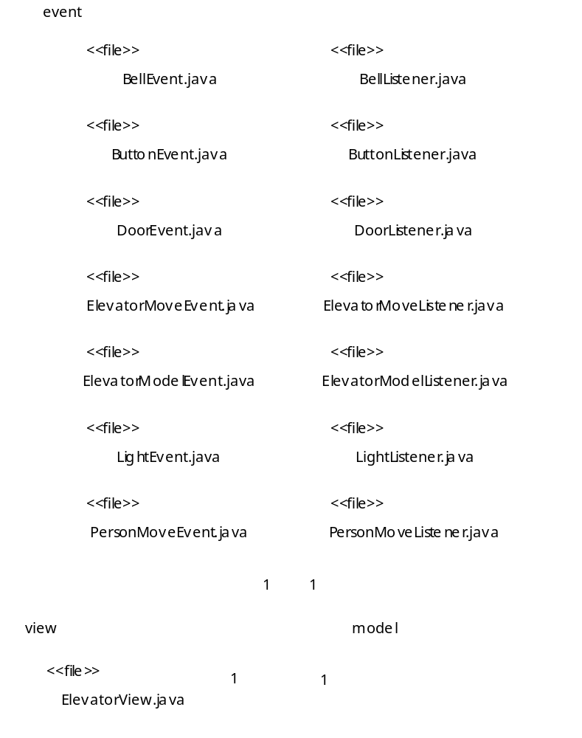
Fig. G.15 Component Diagram for package event.

